Slide 1
Error Control Coding

Slide 2
Concept of redundancy
Systematic generation and addition of redundant bits to the message bits, at the transmitter, such that transmission errors can be minimized by performing an inverse operation, at the receiver. e.g. Triple repetition codes,
Data bit ‘0’ - replaced by the code 000
Data bit ‘1’ - replaced by the code 111
Lower error rate should be obtained for same transmitted power i.e. n coded bits should carry same power as was carried by k uncoded bits.
It endorses the Shannon’s Power-BW tradeoff i.e. for same BER power saving is possible at the expense of more bandwidth as needed in redundant bit transmission.

Slide 3
Code vectors, Hamming Distance
n-bit codeword can be represented as a code vector in a n-dimensional vector space. Each unit weight vector represents a unique dimension/direction.
Only 2^{k} are valid code vectors out of 2^{n} total possible unique vectors.
Detect up to t errors if d_{min} >= t+1
Correct up to t errors if d_{min} >= 2t+1
Code Rate (R_{c}) is defined as k/n
001
011
111
101
000
010
100
110

Slide 4
Triple repetition codes
If probability of transmission error of a channel is ‘x’ per bit and Triple repetition codes are used. Calculate the probability that the received word will be in error when
(a) it is used for error correction
(b) It is used for error detection

Slide 5
P_{we,uncoded} = x
- With triple repetition code
P_{we,detection} = P(3,3) = x³
P_{we,correction} = P(2,3) + P(3,3) = 3x² -2x³
- For any channel with x<<1
P_{we,uncoded} > P_{we,correction} > P_{we,detection}
- The cost is paid in terms of reduction in bit rate.

Slide 6
FEC system
In FEC systems the receiver processes every received data packet. (sometimes it may introduce more errors instead of correcting an existing error).
E_{b} represents average energy per message bit for uncoded transmission then γ_{b} = E_{b}/N₀ and message BER (P_{ube}) = BER by channel = Q(sqrt(2*γ_{b}))
For comparison the message bit energy in coded system should remain same thus energy per code bit should be γ_{c} =R_{c}E_{b}/N₀ and BER by channel (α)= Q(sqrt(2*R_{c}*γ_{b}))

Slide 7
If a code can correct up to t errors in a word then the word error probability due to t+1 errors can be given by P_{we}=^{n}C_{t+1}α^{t+1}(Ignoring (1-α) term and error patterns t+2 to n)
Since in n bit code word there exists t+1 error bits thus message bit error per uncorrected code word = (k/n)(t+1)
When N words are transmitted then total number of erroneous message bits = (k/n)(t+1)NP_{we}
Pbe= [(k/n)(t+1)NP_{we}]/Nk = ^{n-1}C_{t}α^{t+1}
Where, α= Q(sqrt(2*R_{c}*γ_{b}))

Slide 8
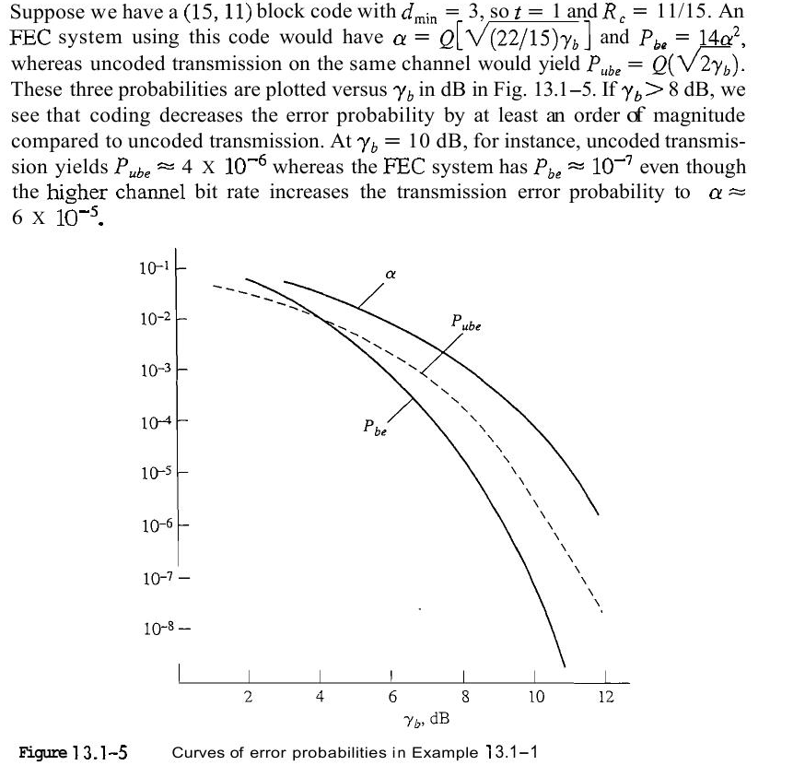

P_{be}= ^{n-1}C_{t}α^{t+1} = ^{n-1}C_{t} [Q(sqrt(2*R_{c}γ_{b})) apprx = e^{-R}_{c}^{γ}_{b} ]^{(t+1)}
coding is beneficial for a reasonably high value of γ_{b}.
(t+1)R_{c}>1 for better performance of FEC system. Also 1 or 2 bit error correcting code words should have relatively higher R_{c}

Slide 9
BEC System
BEC systems uses error detecting codes and retransmission of packet is requested for error correction. An ARQ protocol is used for this purpose
Error Detecting codes
  Horizontal Redundancy Check (HRC)
  Vertical Redundancy check (VLR)
  Cyclic Redundancy Check (CRC)
  Checksum
Automatic Repeat Request (ARQ)
  Stop and wait
  Go Back to n
  Selective repeat/reject

Slide 10
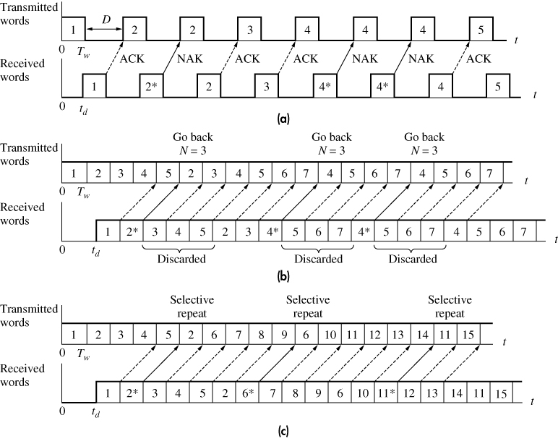
ARQ Techniques

Slide 11
Performance of ARQ
As far as Pbe is concerned (which depends upon undetected errors) the expression for BEC remains same as for FEC but with dmin=t+1.
Clearly, BEC seems advantageous in terms of Pbe but we need to consider loss due to retransmission.
Probability of retransmission p=1-[P(0,n)+Pwe]
p=1- (1-α)^{n} = nα (ignoring Pwe and other terms of (1-α)^{n} expansion)
Find average number of transmitted words per accepted word and the throughput efficiency for srej?

Slide 12
Throughput efficiency Rc’ = (k/n)(1-p)
Transmission bit rate = message bit rate/Rc’
In BEC Rc’ plays same role as Rc in case of FEC thus simply by doing this substitution all the expressions developed for FEC can be used.
Find the expression for Rc’ for other sliding window protocols?

Slide 13
Linear Block codes (n,k)
Requirement for Systematic block codes
[X] = [M | C]
If G be the generator matrix such that
X=M*G
then G must be given as [I_{k} | P].
What should be the dimensions of X, M, C and P?
The parity matrix for generation of Hamming codes should contain all q-bit words with two or more than two 1’s arranged in any order.

Slide 14
(7,4) Systematic Hamming code
The codewords for P = [101; 111; 110; 011]
M | C | W(x) | M | C | W(x)
0000 | 000 | 0 | 1000 | 101 | 3
0001 | 011 | 3 | 1001 | 110 | 4
0010 | 110 | 3 | 1010 | 011 | 4
0011 | 101 | 4 | 1011 | 000 | 3
0100 | 111 | 4 | 1100 | 010 | 3
0101 | 100 | 3 | 1101 | 001 | 4
0110 | 001 | 3 | 1110 | 100 | 4
0111 | 010 | 4 | 1111 | 111 | 7

Slide 15
Syndrome Decoding
H^{T} = P
Iq
H^{T} = P
Iq
(S) | (E)
0 0 0 | 0 0 0 0 0 0 0
1 0 1 | 1 0 0 0 0 0 0
1 1 1 | 0 1 0 0 0 0 0
1 1 0 | 0 0 1 0 0 0 0
0 1 1 | 0 0 0 1 0 0 0
1 0 0 | 0 0 0 0 1 0 0
0 1 0 | 0 0 0 0 0 1 0
0 0 1 | 0 0 0 0 0 0 1
X_{i}*H^{T} = (0 0 0 . . . . .0)_{1xq}
If there is any error then Y_{i} = X_{i} + E_{i}
The operation Y_{i}*H^{T} = E_{i}*H^{T} will generate a non zero (1xq) vector, called syndrome (S).

Slide 16
S = Y*H^{T} = E*H^{T}
All possible error patterns ‘E’ are already known (depending upon error correcting capability of code) and H^{T} is also a known quantity.
Hence, If a code is to correct up to ‘t’ errors per word then
2^{q} – 1 >= n + ^{n}C₂ + ^{n}C₃ . . . . . . + ^{n}C_{t}
(Total no. of syndromes - 1) >= (possible error patterns)
To accommodate the syndrome table the decoder needs to store (q+n)*2^{q} bits. Larger is the table size more time will be required to find error vector thus decoding delay will be increased.

Slide 17
Drawbacks of block codes
The Syndrome decoding requires,
    2^{q} – 1 >= n + ^{n}C₂ + ^{n}C₃ . . . . . . + ^{n}C_{t}
    q*Log (2) >= log{∑ ^{n}C_{i}}; 0<=i<=t ; base =2
    n – k = n*(1-k/n) = log {∑ ^{n}C_{i}}
1 – Rc = (1/n)*log {∑ ^{n}C_{i}}
“Rc should be close to unity in order to minimize overhead but it requires n>>1 which in turn requires more memory space and decoding time.”
If every cyclic shift of a valid code vector produces another valid code vector then it is known as cyclic code.

Slide 18
(7,4) Cyclic code example
M | C | W(x) | M | C | W(x)
0000 | 000 | 0 | 1000 | 101 | 3
0001 | 011 | 3 | 1001 | 110 | 4
0010 | 110 | 3 | 1010 | 011 | 4
0011 | 101 | 4 | 1011 | 000 | 3
0100 | 111 | 4 | 1100 | 010 | 3
0101 | 100 | 3 | 1101 | 001 | 4
0110 | 001 | 3 | 1110 | 100 | 4
0111 | 010 | 4 | 1111 | 111 | 7

Slide 19
Generation of cyclic codes
The cyclic shift of a codeword:
Theorem: If G(p) is a factor of (p^{n}+1) having degree=q then the multiplication of Q_{M}(p)*G(p) will generate a cyclic code; where Q_{M}(p) is any k-bit message though X(p) so generated may not be used as the codeword for the message Q_{M}(p).
X(p) = x_{n-1}p^{n-1}+x_{n-2}p^{n-2}+…..+x₁p+x₀
X = (x_{n-1} x_{n-2} ….. x₁ x₀)
then
X’ =(x_{n-2} ….. x₁ x₀ x_{n-1})
X’(p) = p*X(p) + x_{n-1}*(p^{n}+1)
Hamming codes, BCH codes, Golay codes etc. are examples of cyclic codes.
If there are more than one factor of (p^{n}+1) having degree ‘q’ then choose any factor. It will generate a valid cyclic code but it may not possess optimum error correcting capability

Slide 20
Systematic cyclic codes
For (n,k) code (q=n-k) the requirement is
X(p) = p^{q}*M(p) + C(p)
Combining with cyclic property
Q_{M}(p)*G(p) = p^{q}*M(p) + C(p)
Q_{M}(p) = {p^{q}*M(p)}/G(p) + C(p)/G(p)
{p^{q}*M(p)}/G(p) = Q_{M}(p) + C(p)/G(p)

Slide 21
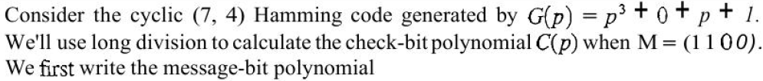
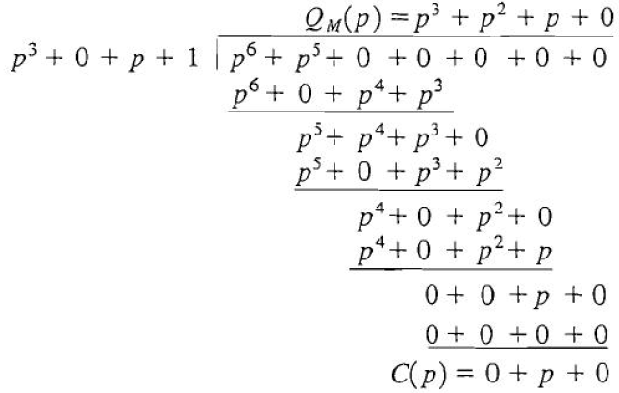

Slide 22
Advantages of Cyclic codes
Simplified encoding and decoding.
Easy syndrome calculation S(p) = rem{Y(p)/G(p)}
Ingenious error correcting decoding methods have been devised for specific cyclic codes. They eliminate the storage needed for table lookup.
Cyclic Redundancy Codes (CRC), a class of cyclic codes, has ability to detect burst errors of length ‘q’, all single bit errors, any odd number of errors if (p+1) is a factor of G(p), Double errors if G(p) has at least three 1’s.

Slide 23
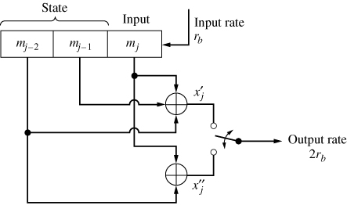
(2,1,2) Convolutional Encoder
n – No. of bits in codeword,
k – No. of fresh input bits used in generation of code,
L – Encoders memory.
Constraint length = n(L+1); some author says its ‘L’.

Slide 24
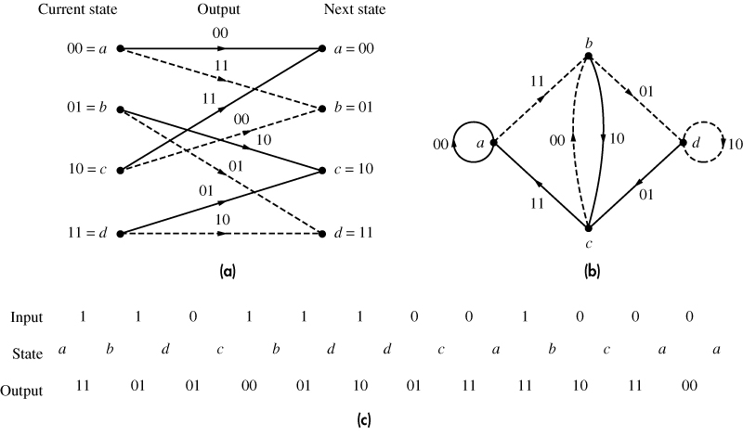
Code Tree, Code trellis and State Diagram

Slide 25
The generator polynomials
Continuing with same encoder
G1(p) = 1+p+p² and G2(p) = 1+p²
The message polynomial
M(p) = 1+p+p³+p⁴+p⁵+p⁸ (see prvs slide)
Xj’ = M(p)*G1(p) = 1+p⁵+p⁷+p⁸+p⁹+p¹⁰
Xj’’ = M(p)* G2(p) = 1+p+p²+p⁴+p⁶+p⁷+p⁸+p¹⁰
Thus Xj =Xj’Xj” =11 01 01 00 01 10 ........... (same result as obtained previously)

Slide 26
The transformation in ‘p-domain’ simplifies the problem as it requires multiplication instead of convolution. (something similar to Fourier Transform of signals.)
In normal operation Xj’ can be evaluated as following operation which is some what equivalent to convolution (refer slide no. 5)
Xj’ = ∑ m_{j-i}*g_{i} (mod-2); for 0<=i<=L

Slide 27
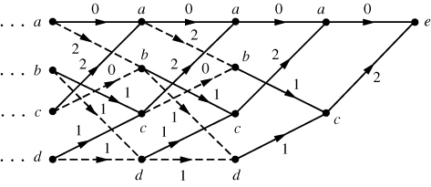
Free Distance
Free Distance (d_{f})= [w(X)]_{min} excluding all zero path.
Termination of trellis (to ensure all zero state for next run and to find min weight non trivial path; = 5 in fig.)

Slide 28
Coding Gain
For a AWGN channel, the decoded error probability for a convolution code having code rate Rc = k/n; and free distance = df can be derived as
P_{be} proportional to e^{-(Rc*df/2)*γb}
P_{be} improves when (Rc*df/2) >1.
By definition, Coding gain = (Rc*df/2) usually expressed in dB.

Slide 29
Catastrophic error
If a finite number of channel errors causes an infinite number of decoding errors.
If all generating polynomials Xj’, Xj’’ …. of Xj has a common factor then it occurs.
Systematic codes are free from this error but they have poor error correcting performance.

Slide 30
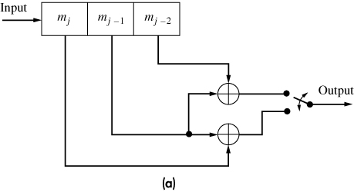
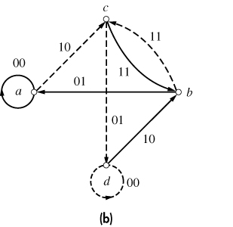
Example:-
G1(p) = 1+p and G2(p) = p+p² has a CF (1+p).

Slide 31
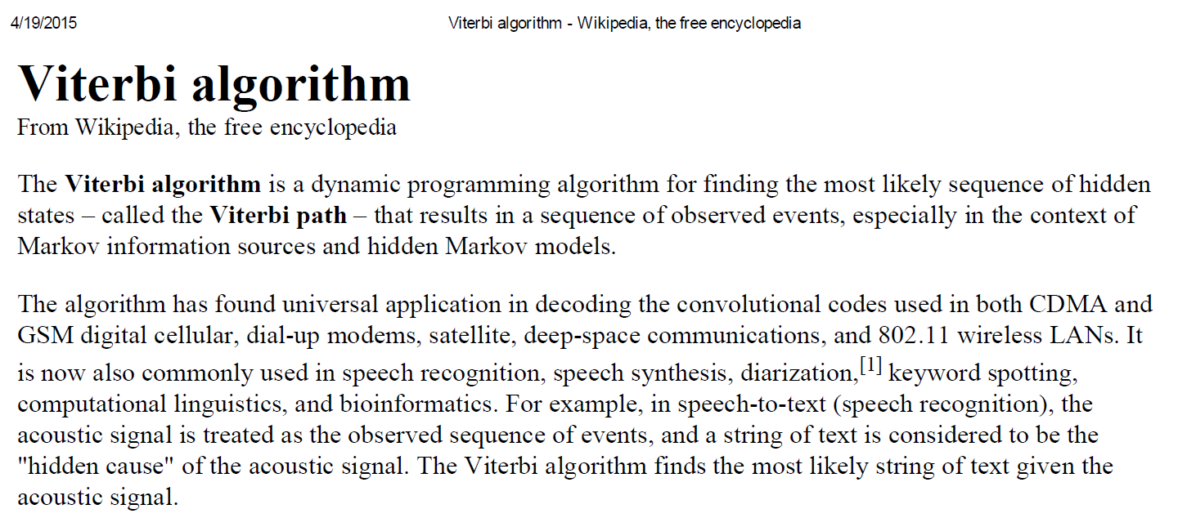

Slide 32
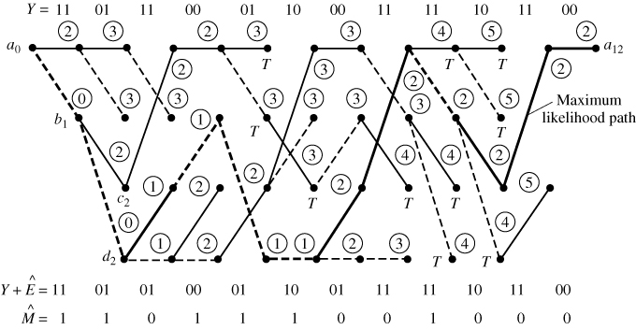
Viterbi Decoding
Maximum error correction, but max delay, high storage and computation requirements

Slide 33
Other Decoding Methods
Sequential Decoding (The output is available after each step. An increasing threshold is used.)
(min delay, min error correction capability)
Feedback Decoding (First output is available after predetermined number of steps (e.g. 3)
(moderate delay, moderate error correction)

Slide 34
Punctured Convolution codes
Transmission efficiency and Coding gain can be improved by increasing code rate Rc.
The decoding of high code rate convolution codes is very complicated due to very complex trellis diagram.
Puncturing technique can be used to improve the effective code rate without increasing the complexity of decoder.

Slide 35
Improving code rate to k’/n’ from 1/n
Choose a matrix P of dimension nxk’.
It should have n’ ones and all other elements as zero.
Consecutive k’ codewords (corresponding to k’ input bits; assuming 1/n encoder) should be compared with k’ columns of matrix P.
Wherever there is a zero in matrix P corresponding bit (may be zero or one) of corresponding code word should be dropped.

Slide 36
Thus total number of bits that are transmitted are n’ for k’ input bits thus effective code rate will be k’/n’.
Same matrix P is used at receiver. Either all zeros or all ones are inserted at the place of dropped bits.
Now it can be decoded using a simple decoder which will treat the puncturing errors as transmission errors.

Slide 37
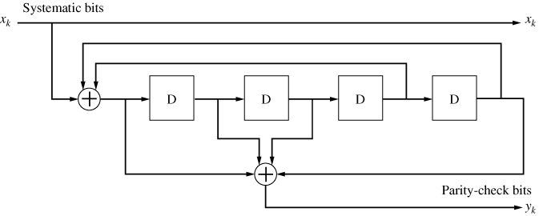
RSC Codes
It is a (23,35) RSC encoder with R=1/2
  Polynomial for feedback connection: 10011 = 23₈
  Polynomial for check bit connection: 11101 = 35₈

Slide 38
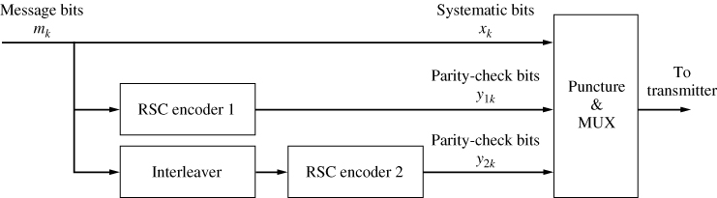
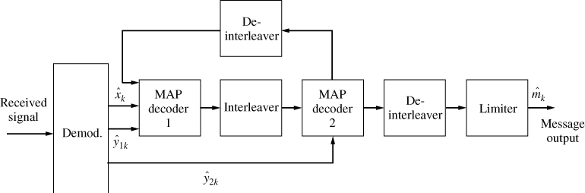
Turbo Codes
almost all codes are good except those we can think of – J. Wolfowitz
Turbo code encoder
Turbo code decoder
Claude Berrou et. Al. ‘Near Shannon limit error correcting coding and decoding’, Proc. IEEE Intl. conf. on comm., Geneva, 1993

Slide 39
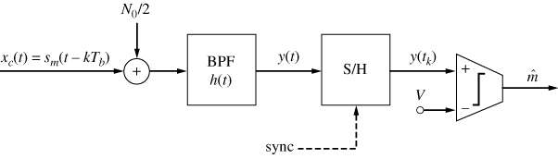
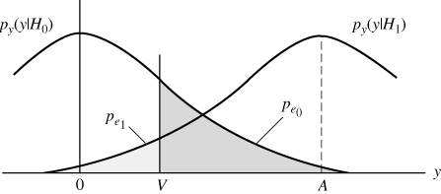
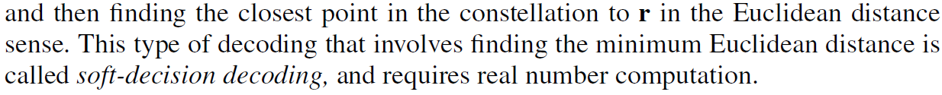
Hard Vs. Soft decision decoding
The representation of demodulator o/p (m) >1 bit corresponds to soft decision decoding.
2dB gain with 3 bit and 2.2 dB with infinite bit representation.

Slide 40
